Slide 1



Carbon Footprint Forecast using Machine Learning
GID-15
Member Details-
Dhruv Borde-16010422132
Kudrat Verma-16010422123
Harshit Bansal-16010422131
Guide Details – Prof. Kiran Kumari (Assistant Professor at KJ Somaiya School of Engineering)

Slide 2

Problem Statement
Climate change and global warming have become major concerns due to rising carbon emissions from industrial activities, transportation, and fossil fuels. Accurate forecasting of carbon footprints is crucial for governments, businesses, and individuals to take informed decisions on reducing emissions and adopting sustainable practices. This project aims to address these challenges by leveraging machine learning regression techniques to develop a robust carbon footprint forecasting model.

Slide 3

Background Work
Several studies have been conducted on carbon footprint estimation using machine learning and statistical models. Traditional methods rely on empirical models and historical data, but they often lack the ability to adapt to changing patterns. Recent advancements in machine learning, particularly in regression-based models, have significantly improved prediction accuracy.
Previous research has focused on using:
Linear Regression for simple trend predictions.
Time-Series Analysis techniques like ARIMA to predict future emissions based on historical patterns.
Decision Tree and Random Forest Models for feature importance analysis and non-linear relationships.
Neural Networks for capturing complex dependencies in large datasets.
Hybrid Approaches that combine multiple techniques to improve predictive accuracy.

Slide 4

Scope (Functional and Non-functional requirements)
Functional Requirements
The model should predict future carbon footprints based on historical trends and real-time data.
The system should allow users to input custom parameters (e.g., energy usage, industry type) for personalized predictions.
The web-based application should visualize predictions using interactive charts and graphs.

Slide 5
Non-Functional Requirements
The system should ensure high availability and reliability.
The user interface should be intuitive and user-friendly.
The system should be compatible with multiple devices (desktop, tablet, mobile).

Slide 6
Dataset Description
Created a .csv file from combining multiple datasets available on https://www.statista.com/
The dataset consists of yearly Carbon Emission in India from 1960 to 2023.
This datasets consists of Carbon Emission from various sources such as Agriculture, Cement Manufacturing, Fossil Fuel Exploitation, Industries, etc.

Slide 7
Dataset References
https://www.statista.com/statistics/1198050/carbon-dioxide-emissions-from-coal-use-in-select-countries/
https://www.statista.com/statistics/1452383/co2-emissions-india-fossil-fuel-and-industrial-purposes-sector/
https://www.statista.com/statistics/1058434/leading-ghg-emissions-fossil-fuel-companies-globally/
https://www.statista.com/statistics/1234578/energy-related-carbon-dioxide-emissions-india/
https://www.statista.com/statistics/1282696/carbon-dioxide-emissions-from-fossil-fuel-use-in-india/
https://www.statista.com/statistics/606019/co2-emissions-india/

Slide 8
Technologies to be used
Programming Languages: Python
ML Frameworks: Scikit-learn, TensorFlow
Data Processing: Pandas, NumPy
Visualization: Matplotlib, Seaborn
Web Development: Flask, HTML, CSS, JavaScript

Slide 9
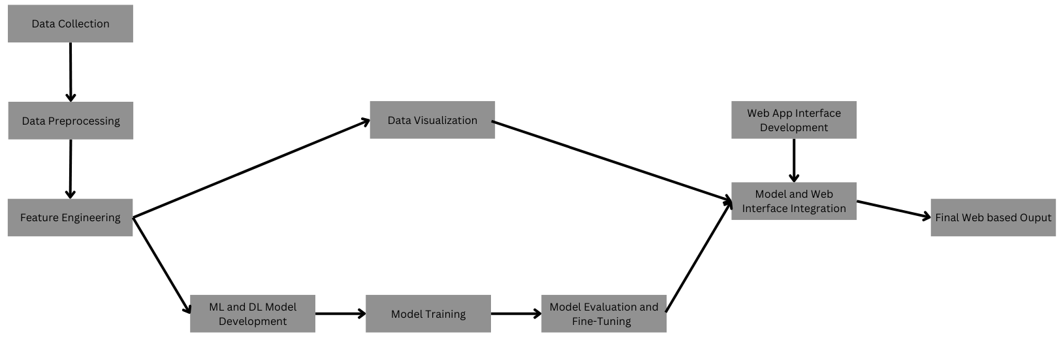
Technologies to be used

Slide 10
Overview of Implementation
Data Collection & Processing: Gather datasets from government agencies, and energy reports. Clean and preprocess the data for machine learning.
Model Development: Use regression models (Linear Regression, Decision Trees) to predict carbon footprints. Train and evaluate models using MAE, MSE, and R-squared.
Visualization: Build a web-based dashboard for visualization using Matplotlib.

Slide 11
Implementation Schedule
January: Define Scope and Data Collection
Collect historical and real-time datasets from reliable sources such as government databases, environmental agencies, and IoT sensors. Perform data preprocessing, including cleaning and handling missing values.
Explore the dataset for correlations and trends.
February: Model Selection, Data Exploration, and Feature Engineering.
Perform feature selection and engineering (e.g., creating new features, normalization, encoding categorical data).
Choose regression-based ML models such as:
Linear Regression
Decision Tree Regression
Random Forest Regression
Split the dataset into training, validation, and test sets.

Slide 12
Conclusion
Expected Outcomes
An accurate carbon footprint prediction model.
A user-friendly dashboard displaying real-time insights.
A comprehensive project report outlining research, implementation, and findings.
Further Scope and Solution
In addition of Completion of the model with a Web based interface, we will be providing a report based on our finding which aims to summarize multiple findings discovered throughout the building of the overall Project.

